Slide 1
Preparing a successful CEDAR Coal Study Unit
Notes:
Hi. We wanted to share this slide show for you so that you would be better prepared to complete a successful Cedar Coal Study Unit. It is based on things we commonly see that detract from the score of a unit. We hope this will assist you in improving the units you submit.

Slide 2
Essential Questions: What do your students want to know about coal and current issues regarding this natural resource?
(Minimum of three) Make these thinking questions: How & Why?
List the KY Academic Standards. (List standard and briefly explain).
List learning targets or “I can” statements that match each standard.
List how each target will be assessed (one assessment can assess more than one target, but it should be clear how each is assessed).
List and give a brief description of activities that students will engage in during this unit.
NOTE: Students’ products may be included as evidence for a school’s Program Review.
List supplies needed to complete each activity.
List the cost of each supply-item for which you are requesting grant money.
Notes:
These are the elements that we ask for as you develop the unit. Each of them should be tightly tied to the others.

Slide 3
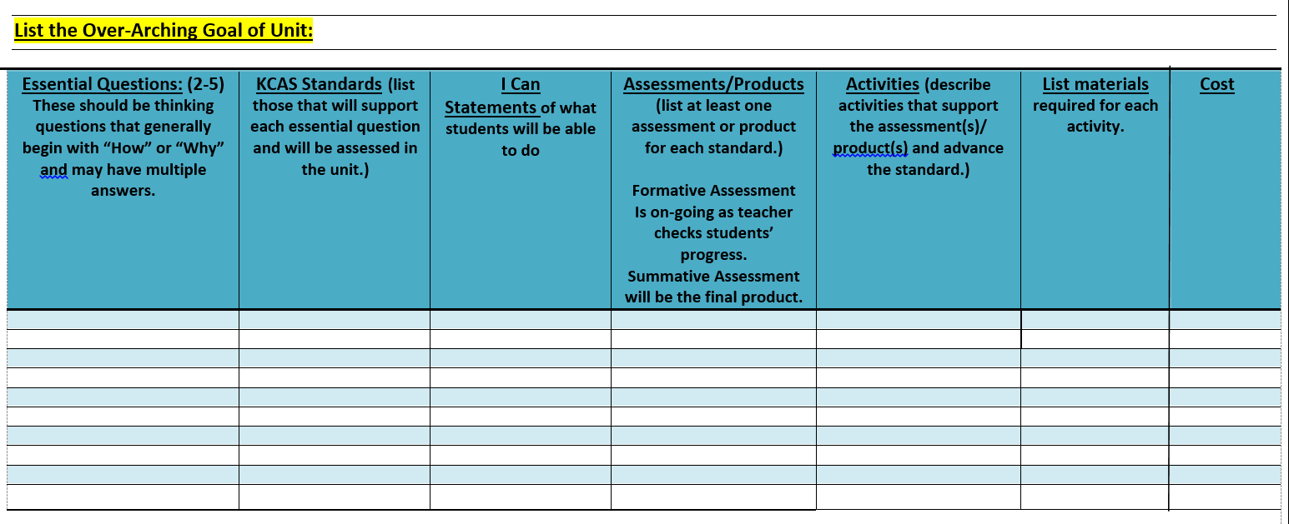
Notes:
Each of the elements is to be entered into the grid. The grid is designed so that the relationship between each element is clear. Reviewers want to be able to look across the grid and see standards that relate to to the essential question, learning targets that come from the standards, assessments that would reveal the ability to know/do the learning targets, activities that would make the assessments possible, materials that would allow students to complete the activities and the cost of each of those materials. If you put the first essential question into the first blue row, each of the other elements that relate to that essential question should go into the same blue row. The next essential question and all of its related material will then go into the first white row.
The first thing that is asked for, even before we get to the grid, however, is the over-arching goal of the unit.

Slide 4
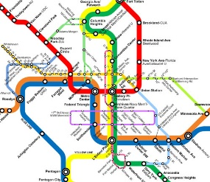
Notes:
So, let’s look first at the focus element of your unit. The focus should be relevant to your students, which means it should be grade appropriate and meaningful to them.
It should also be specific and, well, focused. Let’s look at some examples.
This one is asking kids to focus on too much at once. It is all over the map and would take all year to accomplish.
This one is biased. It is telling students what to think. The goal of Cedar isn’t to bias students toward a coal economy, but to give them the tools to think through issues and problems and to begin to develop ideas and solutions. If your unit shows bias, you will be asked to resubmit.
This goal is very narrow and doesn’t expect much thinking from the students. It might be difficult to build an entire unit around just this statement.
This goal is focused—we know what students are working toward and it is achievable in the time frame of a unit. However, it leaves room for students to ask and answer a variety of questions within the focus, so it is not so narrow that it limits the engagement of the students. It is not biased because it doesn’t tell students what their opinion should be or what the impact on the local economy will be.

Slide 5
A question is essential when it:
causes genuine and relevant inquiry into the big ideas and core content;
provokes deep thought, lively discussion, sustained inquiry, and new understanding as well as more questions;
requires students to consider alternatives, weigh evidence, support their ideas, and justify their answers;
stimulates vital, on-going rethinking of big ideas, assumptions, and prior lessons;
sparks meaningful connections with prior learning and personal experiences;
naturally recurs, creating opportunities for transfer to other situations and subjects
Notes:
Once you have a focus, you will begin with the essential questions. Essential questions are tricky. Here are some characteristics. The key is that the essential questions should open up the unit to the students. It should give them a reason to do the activities in the unit that you will describe later.

Slide 6
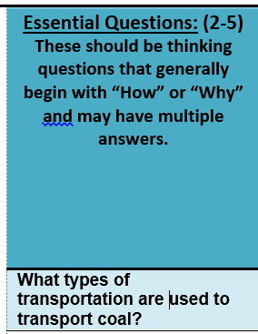
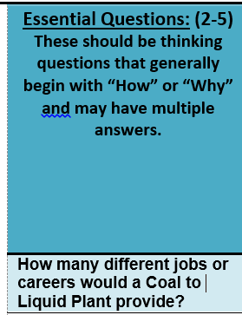
Could answer with a list.
No connection to students’ lives.
Little opportunity for genuine interest.
Narrow range of answers.
Little connection to students’ lives.
Little opportunity for genuine interest.
How does transporting coal affect my daily life?
How would a coal to liquid plant change lives in Eastern Kentucky?
Why would I want to vote for or against zoning to permit a coal to liquid plant in my county?
Why is coal transporting important to me?
Notes:
Here are some examples of essential questions from units. Let’s examine if they are essential, according to the characteristics we just saw.
So, this question could be answered with a list, has no real connection to students or their lives, and doesn’t have much opportunity to pull kids in.
These might be questions that they would be more interested in exploring. Also, these questions don’t just need a list as an answer.
This question also has a narrow range of answers and little tug on students’ interests.
These questions open up the kinds of answers called for and make a connection to the student.

Slide 7
Essential Questions: (2-5) These should be thinking questions that generally begin with “How” or “Why” and may have multiple answers. | KCAS Standards (list those that will support each essential question and will be assessed in the unit.) | I Can Statements of what students will be able to do | Assessments/Products (list at least one assessment or product for each standard.) Formative Assessment Is on-going as teacher checks students’ progress. Summative Assessment will be the final product. | Activities (describe activities that support the assessment(s)/ product(s) and advance the standard.) | List materials required for each activity. | Cost
W-8-1a-b: Write arguments to support claims with clear reasons and relevant evidence.
Be sure you are using the newest standards!
W-8-1a-b
Writing
Notes:
Each essential question should be connected to at least one KAS standard. These standards may come from any subject area, including art, music, tech, etc., but should be written out in the space, along with the reference (e.g. R.8.6). If only part of the standard is addressed, you need only put the reference and the part of the standard to be addressed.
So, lets look at some things we commonly see in this space and determine if they are effective.
This will not work because it doesn’t tell us the standard that students are expected to meet, only the subject area.
This one is better, but if this is all we have, we have to spend a great deal of time looking up what that standard actually says.
This is the one that gives us all of the information we need.
Remember to use the newest standards for which you are accountable. You shouldn’t be teaching to standards which are no longer required in Kentucky!

Slide 8
Essential Questions: (2-5) These should be thinking questions that generally begin with “How” or “Why” and may have multiple answers. | KCAS Standards (list those that will support each essential question and will be assessed in the unit.) | I Can Statements of what students will be able to do | Assessments/Products (list at least one assessment or product for each standard.) Formative Assessment Is on-going as teacher checks students’ progress. Summative Assessment will be the final product. | Activities (describe activities that support the assessment(s)/ product(s) and advance the standard.) | List materials required for each activity. | Cost
W-8-1a-b: Write arguments to support claims with clear reasons and relevant evidence.
I can write a research paper.
I can communicate my claims with clear reasons and relevant evidence through writing.
I can write an argument.
This means I can state my claim and give clear reasons for my claim and relevant evidence to support it.
Notes:
There should be at least one learning target or “I can” statement for each standard. The target should tell specifically what the students will know or be able to do when they finish the unit. They should be connected to the standard and completion of each target should lead to understanding of the standard.
So, which of these targets makes the most sense with this standard? The red one is the best connected.
The pink one may be modified into a target with success criteria. For example, I can write an argument. This means that I can state a claim and give clear reasons for my claim and relevant evidence to support my claim.

Slide 9
Essential Questions: (2-5) These should be thinking questions that generally begin with “How” or “Why” and may have multiple answers. | KCAS Standards (list those that will support each essential question and will be assessed in the unit.) | I Can Statements of what students will be able to do | Assessments/Products (list at least one assessment or product for each standard.) Formative Assessment Is on-going as teacher checks students’ progress. Summative Assessment will be the final product. | Activities (describe activities that support the assessment(s)/ product(s) and advance the standard.) | List materials required for each activity. | Cost
Notes:
There should be at least one assessment or product for each standard. You may have one for each target, but if not, the assessment for the standard should clearly show how each target is assessed. For example, if the assessment is a project, one should see how the targets allow the project to be completed.

Slide 10
Essential Questions: (2-5) These should be thinking questions that generally begin with “How” or “Why” and may have multiple answers. | KCAS Standards (list those that will support each essential question and will be assessed in the unit.) | I Can Statements of what students will be able to do | Assessments/Products (list at least one assessment or product for each standard.) Formative Assessment Is on-going as teacher checks students’ progress. Summative Assessment will be the final product.
How can I convey my feelings about coal mining in Eastern Ky through visual art? | 4-VA:Cn10.1.4 Create works of art that reflect community cultural traditions. 4-VA:Cr3.1.4 Revise artwork in progress on the basis of insights gained through peer discussion. 4-VA:Cr2.2.4 When making works of art, utilize and care for materials, tools, and equipment in a manner that prevents danger to oneself and others. | I can create a work of visual art that expresses the feelings of myself and/or my community about coal mining. I can use feedback from my peers to improve my artwork. I can use material safely. | Students will create a work of visual art which conveys their feelings and/or their communities feelings about coal mining. They will use rubrics to give one another feedback on the work and on the use of materials as they work.
Notes:
Here is an example of using one performance or project assessment that combines all of the learning targets. Notice that I can pick out each of the learning targets in the assessment.
You may also have a separate assessment for each target, but either way, all targets must be assessed.

Slide 11
Essential Questions: (2-5) These should be thinking questions that generally begin with “How” or “Why” and may have multiple answers. | KCAS Standards (list those that will support each essential question and will be assessed in the unit.) | I Can Statements of what students will be able to do | Assessments/Products (list at least one assessment or product for each standard.) Formative Assessment Is on-going as teacher checks students’ progress. Summative Assessment will be the final product. | Activities (describe activities that support the assessment(s)/ product(s) and advance the standard.) | List materials required for each activity. | Cost
Notes:
Activities should build students’ ability to be successful on the assessments. In that way, they should connect back to the targets, the standards, to the essential question, and to the focus of the unit. Give enough detail so that we can see that connection!

Slide 12
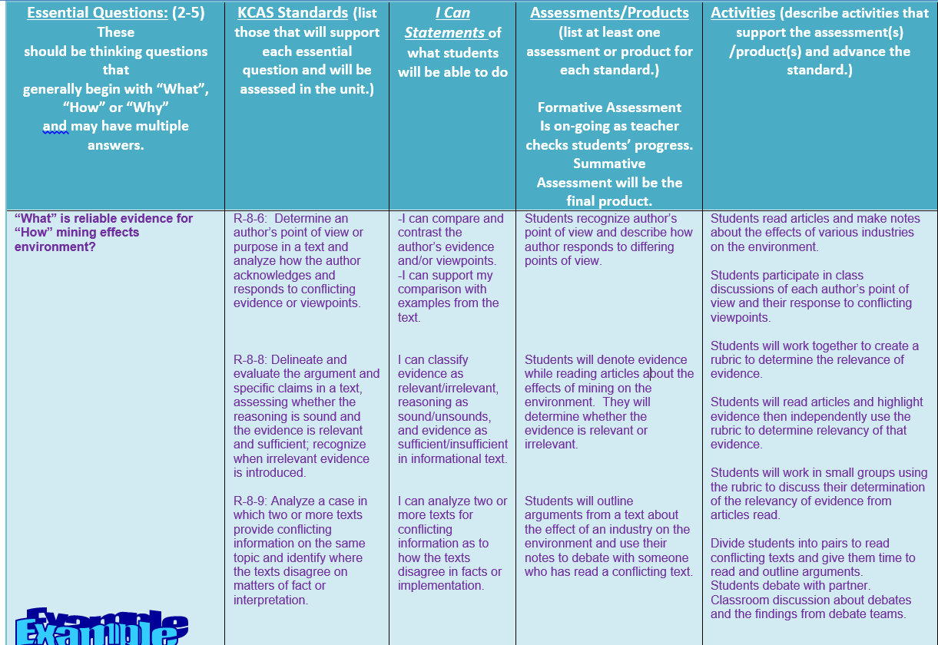
Notes:
The first activity is the set up—it will be used for all the rest.
This second activity will allow students to be successful on the first assessment.
The third and fourth activities provides the instruction that will lead to the ability to do the second assessment.
The last activity provides the instruction that will help students to be successful on the final assessment.

Slide 13
Essential Questions: (2-5) These should be thinking questions that generally begin with “How” or “Why” and may have multiple answers. | KCAS Standards (list those that will support each essential question and will be assessed in the unit.) | I Can Statements of what students will be able to do | Assessments/Products (list at least one assessment or product for each standard.) Formative Assessment Is on-going as teacher checks students’ progress. Summative Assessment will be the final product. | Activities (describe activities that support the assessment(s)/ product(s) and advance the standard.) | List materials required for each activity. | Cost
Notes:
The materials for each activity should be listed. It should be clear how those materials will be used in that activity. This is most easily explained in the activities, because there is more room in that column. The cost for each material should be listed beside of the material in the next column.

Slide 14
Activities (describe activities that support the assessment(s)/ product(s) and advance the standard.) | List materials required for each activity. | Cost
Students read articles and make notes about the effects of various industries on the environment. Students participate in class discussions of each author’s point of view and their response to conflicting viewpoints. Students will work together to create a rubric to determine the relevance of evidence. Students will read articles and highlight evidence then independently use the rubric to determine relevancy of that evidence. Students will work in small groups using the rubric to discuss their determination of the relevancy of evidence from articles read. Divide students into pairs to read conflicting texts and give them time to read and outline arguments. Students debate with partner. Classroom discussion about debates and the findings from debate teams. | Paper to print articles (3 pks) None Chart paper Chart markers Highlighters Articles None Articles None | $11.00 $0.00 $30.00 $10.00 $20.00 $0.00 $0.00 $0.00 $0.00
Be sure each item is clearly connected to the activity!!!
Notes:
Make sure that you’re not asking for materials without having a clear connection to the activities. If you are asking for something and you are not sure we will know what it is or what it is for, please elaborate. That’s easier than it being sent back to you and it is better than a really great activity not being funded because we didn’t have a clue!

Slide 15
To Review
Overarching goal should be focused, but not too narrow, relevant to the grade level and content you are teaching, and unbiased—teach kids how to think, not what to think!
Essential question(s) should be rich, thought provoking, and engaging to students.
At least one standard should tie to each essential question. Current Kentucky Accademic Standards should be written out along with the alphanumeric reference.
At least one learning target/I can statement should be connected with each standard.
At least one assessment should clearly connect to each target.
Activities should prepare students to be successful on the assessments listed.
It should be clear how the materials listed for each activity will be used in the activity and the cost for each should be beside of that material.
Notes:
We hope this presentation has made the process of developing your unit clearer for you. Please let us know if you still have questions that we need to address. Thank you, and good luck!

